Slide 1





Aras Innovator
RoHS Overview
Solutions for Performance Driven Companies
September 2006

Slide 2
Aras Innovator
RoHS Solution Overview
Companies struggling with Environmental Compliance
RoHS solution template developed
Available for specific configuration & customization based on customer process requirements

Slide 3

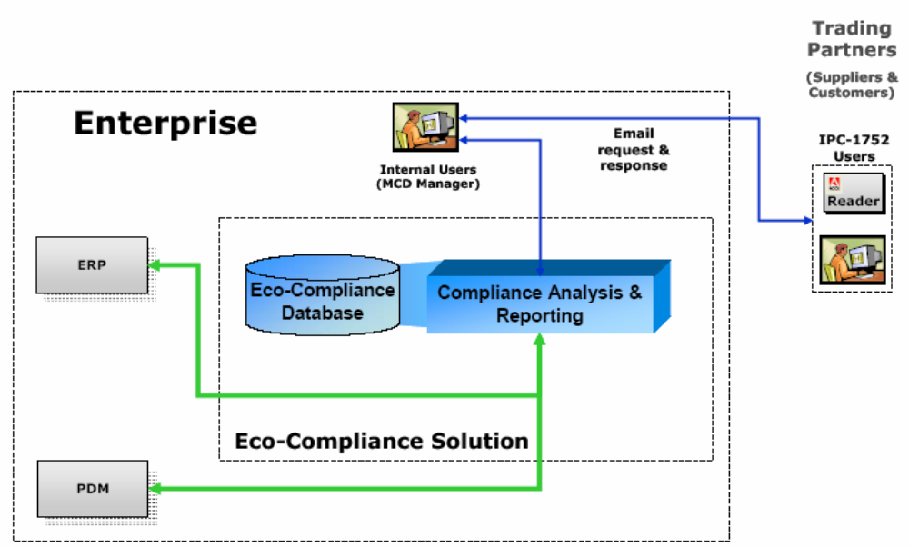
Reference Model
Recommended Set-up
Company

Slide 4
RoHS Solution Goals
Simplify & structure Environmental Compliance data
  Single, secure real-time views & single version of the truth
  Allows tracking of Component and Product level compliance
  Manage IPC-1752 MCDs and other forms & formats online
  Extensible to address future requirements
Simplify monitoring & reporting to regional regulations
  Visibility into compliance risks
  Single view for Part by Part status to all regulations
Provide online access for Rapid Response
  Enables companies to successfully contest border challenges
  Global online access to complete info
  Consistent format for fast & easy reference

Slide 5
RoHS Structure
Environmental
Compliance
Report
Product Level
Part Level
Material
Composition
Delaration
Material
Composition
Delaration
Material
Composition
Delaration
Output
Input
Compliance Library
Substance Library
BOM
Regulation
Part
Regulation
Regulation
Weight
Max Temp
Substance
Threshold
Material
Substance
Substance
PPM
1
1
2
2
N
N
Each Part can have as many Substances as relevant
Add Regulations to Library as needed; Automatically checks against Parts
Stores MCD data in database and forms in vault associated to Parts

